Slide 1
Cpts483 Intro to Robotics
Instructor: Matt Taylor PhD.
TA: Faustino Lukolo

Slide 2
So Far..
We have looked into:
  Creating catkin workspace
  Source devel/setup.bash from ~/catkin_ws
  Configure your IDE of choice
Next:
  Create metapackage dana_sim
    Modify package.xml
    Modify CMakeList.txt
  Create package dana_talker winthin dana_sim
    Modify package.xml
    Modify CMakeList.txt
    Add source files to package dana_sim (e.g. talker_node)
  Create package dana_listener within dana_sim
    Modify package.xml
    Modify CMakeList.txt
    Add source files to package dana_sim (e.g. listener_node)

Slide 3
Graphical way!
Using ROSBride (Brics IDE)
  BRIDE is a model driven engineering tool chain based on Eclipse. It is developed as part of the BRICS project.
  http://wiki.ros.org/bride

Slide 4
How does bride work
In manually created ROS components:
  ROS-specific code parts are usually mixed with the framework-independent algorithmic core of a component.
BRIDE:
  Allows for a clear separation of framework-independent and framework-specific code: Component interfaces and behaviors are modeled in an abstract representation.

Slide 5
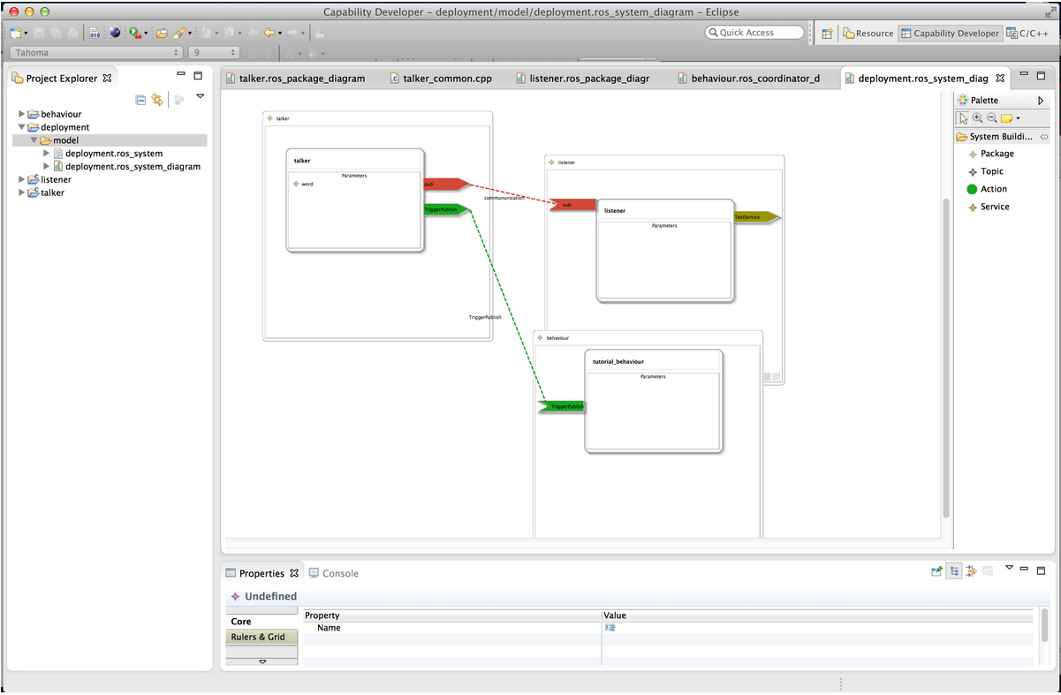
UI

Slide 6
Key Features
The ROS-targeting of BRIDE gives you the following concrete features:
  Graphical modelling of ROS nodes
  Generation of source code in C++ or Python for the modeled ROS node with topics, services, dynamic_reconfigure and dependencies
  ROS independent program stub for your algorithm/driver/...
  Graphical modelling of ROS systems
  Generation of launch files with parameters, "remap"-ing and dependencies

